Slide 1
Media Influence
Every day we draw meaning from the textual and visual images in our environment.

Slide 2
This presentation is about how to use a brainteaser to introduce students about the concept of
Environmental Printing

Slide 3
  Before children can read, they can identify their favorite food from the font and image on the cereal box. The influence of the media is pervasive almost before children can talk.

Slide 4
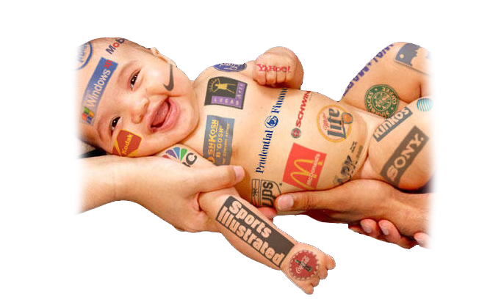
The average high school student spends more than 40 hours each week consuming media (TV, music, film, video games, internet)
The average child sees more than 20,000 commercials each year, and advertisers begin to target individuals at birth.

Slide 5
Literacy specialists call this
environmental printing.

Slide 6
  With such obvious impacts, and the number of messages that are filtered every day, the challenge is to give young people critical thinking skills and build creative talent to produce an increasingly wide range of messages using image, language, and sound.
One purpose of the YEA! program is Media literacy as it relates to tobacco and developing the ability to encode and decode the symbols transmitted via media and the ability to synthesize, analyze and produce mediated messages.
Media education is the study of media, including ‘hands on' experiences and media production.

Slide 7
Two panels of the initial letters of brand name logos follow. In the quiz you took earlier, you identified each separately. You will be able to compare your answers with your students. This activity can serve as:
An icebreaker or brainteaser in your classrooms.
A learning object that lends itself to action research as you, the teaching adult, compare your answers with those of your students.
A means to reflect on the experiential and generational differences regarding meaning. data from the results of the two groups can then be compared.

Slide 8

Notes:
A: ALL
B: BUBBLICIOUS
C: CAMPBELLS
D: DAWN
E: EGGO
F: FRITOS
G: GATORADE
H: HEBREW NATIONAL
I: ICE
J: JELLO (SUGAR FREE)
K: KOOLAID
L: LYSOL
M: M & M'S
N: NILLA WAFERS
O: OREO
P: PEZ
Q: Q-TIPS
R: REESE'S
S: STARBURST
T: TIDE
U: UNCLE BEN'S
V: V8
W: WISK
X: XTRA LAUNDRY DETERGENT
Y: YORK PEPPERMINT PATTIES
Z: ZEST

Slide 9

Notes:
Adobe, Barbie, Coca-Cola, Disney, eBay, Fila, Google, H&M, IBM, Johnson’s, Kellogg, Lego, MTV, Nintendo, O and Company (need to verify) ,Puma, Quicktime, RAC (need to replace), Sega, Texaco, Unilever, Virgin, Walkman (Sony), Xbox, Yahoo, Zurich (insurance company)

